Slide 1
Integrating diverse genomic data using gene sets
Alex Sánchez

Slide 2
Background
Nowadays it is possible to simultaneously make several [gen]omic measures in the same sample.
Transcription, Genotype variation, CNV, methylation
Cancer genome projects have been at the forefront of this trend, and have faced the challenge of integrating these diverse data types [1,2], including RNA transcriptional levels, genotype variation, DNA copy number variation, and epigenetic marks

Slide 3
Gene Sets
Integration may be helped by annotated collections of gene sets capturing established knowledge about biological processes and pathways.
Many Collection of gene sets available:
MSigDb
One can make inferences about a given gene set using several different genomic data types, →
Gene set analysis provides a direct and biologically motivated approach to analyzing multiple data types in an integrated way

Slide 4
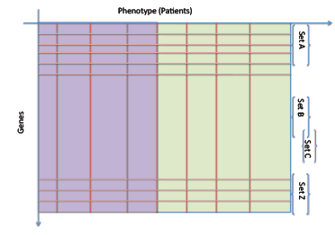
Why gene set analysis
Main question: what makes two (or more) phenotypes dierent
tumor vs normal,
short vs long, survival, molecular subtypes, etc.
Major problems: data are noisy, the signal is subtle, results hard to interpret in a biologically meaningful way

Slide 5
Traditional approach
Find some gene-to-phenotype association score (say, using t-test, ANOVA, etc.)
Rank genes according to the score and take top-'your favorite number' or assess statistical signicance of the discriminating power of each gene
Adjust by Multiple testing
It is not uncommon that similar studies report nonintersecting lists of "top genes"
Individual genes might not contribute too much to the difference between phenotypes, together, though, they might!

Slide 6
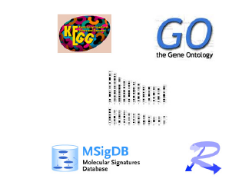
Gene Set Analysis
Instead of 'list of genes' think about 'list of gene sets'
Gene sets encompass larger amount of biological information,
this helps to make results more interpretable.
Information on the gene set level is comparable across different types of measurements (different platforms)
Multiple testing issue: we will usually (not always...) have less
sets than individual genes
Same biological mechanisms can manifest in different parts of the pathway and via different alterations in different
subjects (!!!)

Slide 7
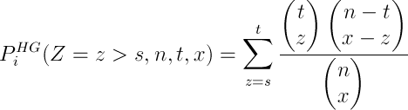
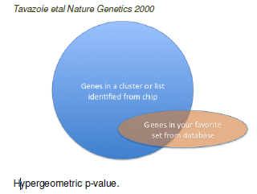
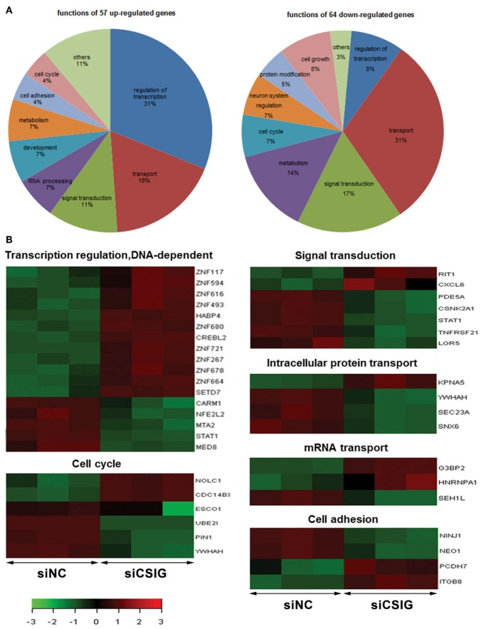
Overrepresentation analysis

Slide 8
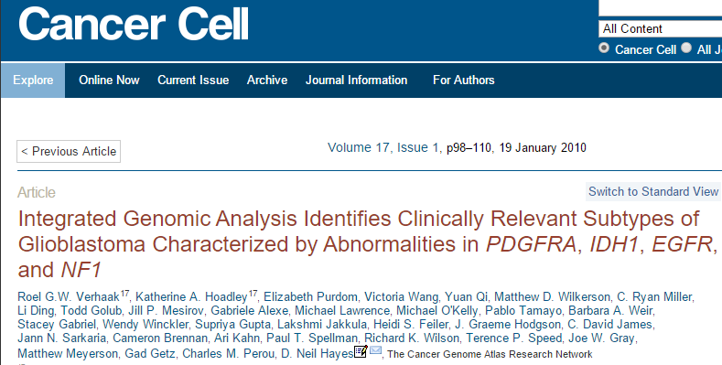
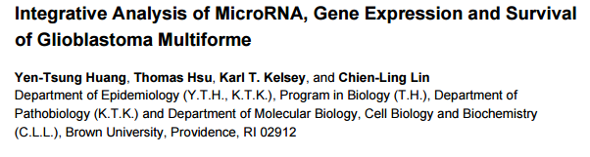
Case study: Glioblastoma multiforme
Glioblastoma multiforme (GBM) - very aggressive and the most common primary brain tumor
primary (90%-95%), secondary (5%-10%)
median survival 15 month

Slide 9
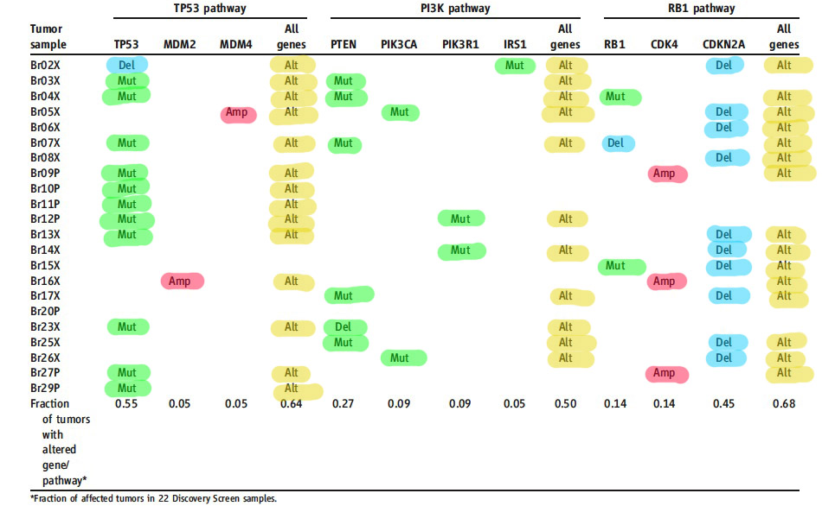
Pathways altered in GBM

Slide 10
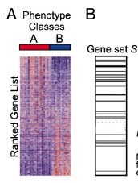
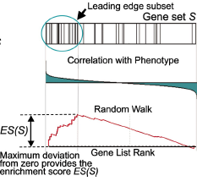
Gene Set Enrichment Analysis
Two stage analysis
Stage I: compute some gene-to-phenotype association scores (say, t-values) and rank genes according to these values
Stage II : check whether the distribution of the ranks is different in a given set vs the rest of the genes (sets) { competitive null, or vs the distribution of the ranks in the same set when there is no association with the phenotype { self-contained null
Infer enriched sets, say by ranking sets according to the outcome of the Mann-Whitney or Wilcoxon test.
Supposedly, this approach allows to tease out subtle signals.

